Slide 1
FINAL TASK
4°1
1- Obligation,
2- Absence de nécessité,
3- Autorisation,
4- Interdiction,
5- Comparatif.

Slide 2

Hi Josh Welcome to France my name is Adam I will explain to what you can and what you can’t .

Slide 3
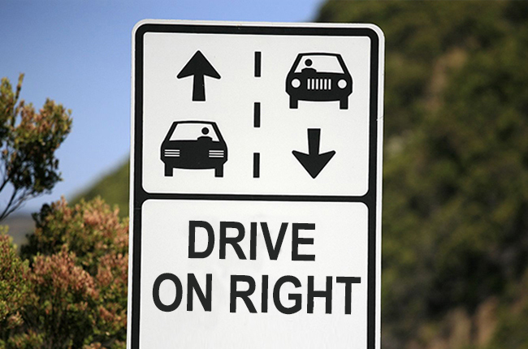
Obligation
In France you must drive On the right.

Slide 4

Absence de nécessité
In France yon don’t have to wear a uniform Unlike England

Slide 5
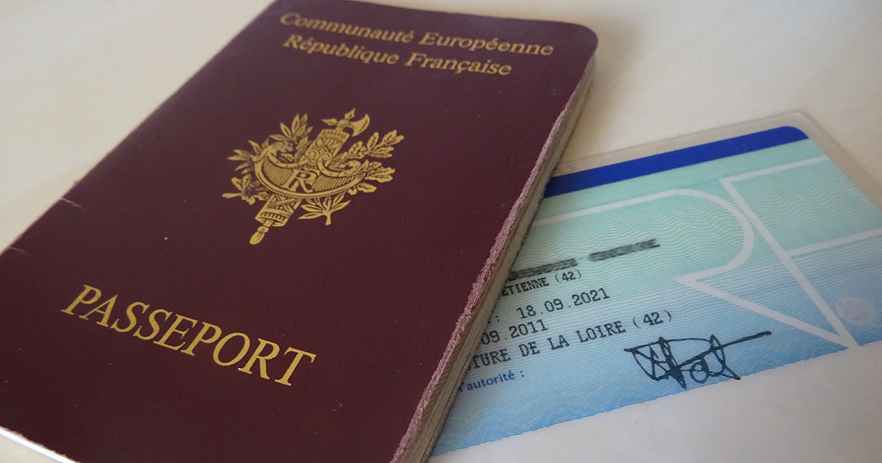
Autorisation
In France you can have a passport at birth Unlike England.

Slide 6


Interdiction
In France You not allowed to Left school without permission.

Slide 7
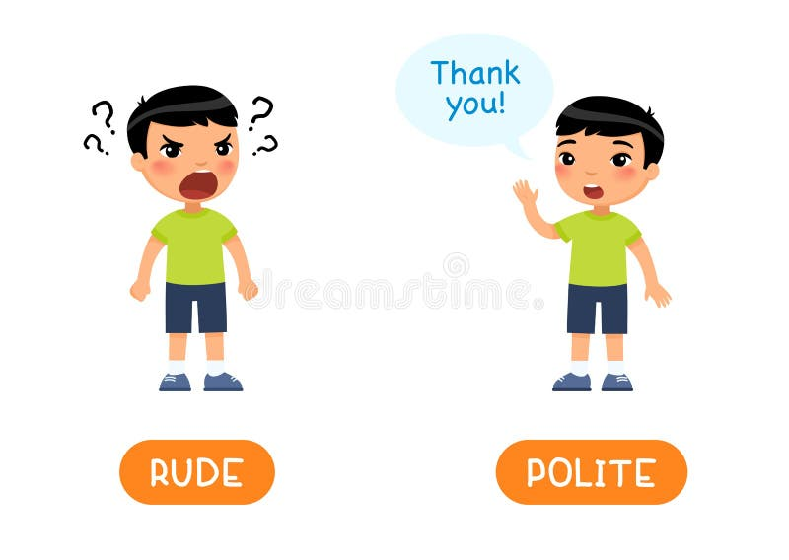
Comparatif
The English are more polite than the French.

Slide 8

Fin
De Adam 4°1

