Slide 1

Welcome in France

Slide 2
Hi Josh! I will show you the difference between the France and the U.K!

Slide 3
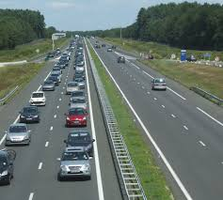
The difference the obligation unlike in the uk in France you must drive on the right

Slide 4



the difference at school in the uk you must wear a uniform.in France you are allowed to choose your clothes every day. in school you have to use the world <<vous
» for tell you teacher it is more polite

Slide 5

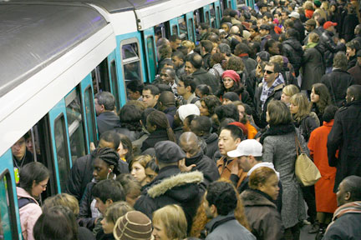
The comparaisons
The uk people are more patient and ponctual than french people

